Slide 1
Aggregation, Composition, and Dependence Relationships Among Classes

Slide 2
Aggregation Relationship
Represents whole-part relationship
Represented by a diamond symbol at the aggregator end.
Often indistinguishable from plain association. However:
  Aggregate usually creates the components:
  Aggregate usually invokes the same operations on all its components.
Usually aggregate is owner of the components:
  But may share with other objects
*
*
1
Company
Person
Club
employs
memberOf

Slide 3
Aggregation: Two Examples
1
*
*
1
Document
Paragraph
Line
1
*
*
1
Company
Person
Club
employs
memberOf

Slide 4
Aggregation cont…
An aggregate object contains other objects.
Aggregation limited to tree hierarchy:
  No circular inclusion relation.
1
*
Line
Paragraph

Slide 5
Composition
A stronger form of aggregation
  The whole is sole owner of its part.
    A component can belong to only one whole
  The life time of the part is dependent upon the whole.
Circle
1
Point
Circle
3..*
Point
Polygon

Slide 6
Composition Relationship
Life of item is same as that of order
Order
Item
1
*

Slide 7
Composition: Alternate Notation
Car
4
1
Wheel
Engine
2
1
Door
Chassis
1
1
Axle
Steering

Slide 8
Composition
An object (component) may be a part of ONLY one composite.
  Whole is responsible for the creation and disposition of its parts.
Window
whole
1
*
Frame
part

Slide 9

Aggregation vs. Composition
Composition:
  Composite and its components have the same life line.
Aggregation:
  Lifelines are different.
Consider an order object:
  Aggregation: If order items can be changed or deleted after placing an order.
  Composition: Otherwise.

Slide 10
Composition versus Aggregation
1
*
Order
Item
Composition
1
Order
*
Item
Aggregation

Slide 11
Implementing Composition…
public class Car{
private Wheel wheels[4];
public Car (){
wheels[0] = new Wheel();
wheels[1] = new Wheel();
wheels[2] = new Wheel();
wheels[3] = new Wheel();
}
}
1
4
Car
Wheel

Slide 12


Slide 13
Aggregation: Code Example
An aggregation relationship is usually represented as a data field in the aggregated class.
public class Name {
/* Data fields */
/*Constructors */
/* Methods */
}
public class Person {
/** Data fields */
private ArrayList<Name> name =new ArrayList<Name>() ;
}
public class Address {
/* Data fields */
/*Constructors*/
/** Methods */
}
*
Name
1
Person
*
Address

Slide 14
Often Inner Classes are Used
If House is used only in the Person class:
  Declare it as an inner class in Person.
public class Person {
private Name name;
private House house;
...
class House {
...
}
}

Slide 15
Implementing Aggregation: Ex 1
import java.util.ArrayList;
public class CarShop{
CarCompany company; Manager manager;
private ArrayList<SalesPerson> people = new ArrayList<SalesPerson>();
private ArrayList<Car> cars = new ArrayList<Car>();
}
*
Car
1
Car Shop
*
Salesman

Slide 16
Implementing Aggregation: Ex 2
Class Aggregator{
public static void main() {
BufferedReader br=new
BufferedReader(new
InputStreamReader(System.in));
Paragraph p= new Paragraph();
do{
p.addSentence(new Sentence(br.readLine());
}
}
}
Public class Sentence{
String text;
Sentence(String ){text=s;}
}
Public class Paragraph{
private ArrayList <Sentence>
sentList=new
ArrayList<Sentence>();
public addSentence(Sentence s){
sentList.add(s);
}
}
1
*
Pragraph
Sentence

Slide 17
Deciding Whether to Use Composition or Aggregation…
Use composition if:
  Lifetime of part is bound within lifetime of composite
  There is an obvious physical or logical assembly
  Some properties of composite propagate to parts (e.g., location)
  Operations applied to composite propagate to parts (e.g., destruction, movement, etc)

Slide 18
Class Dependency
Dependent Class
Independent Class
Any change to the independent class would necessitate a change to the dependent class.
A class may be dependent on another class due to a variety of reasons.

Slide 19
Dependency
Dependency relationship between two classes X and Y can arise due to a variety of reasons:
  X has an attribute of class Y
  X has a template attribute with a parameter of class Y
  X has a method with an input argument of class Y
  X has a method with an output argument of class Y
  X has of a method containing a local variable of class Y
  Etc.

Slide 20
Dependency
Common Dependences are caused by:
  Local variable
  Parameter
  Return value
Example:
  Class A { Class B {
  B Foo(B x) { …
  B y = new B(); …
    return y; …
  }
  } }

Slide 21
Dependence – Examples
class MyDependentClass{
void myFunction1( MyReferencedClass r ) { .. }
MyreferencedClass myFunction2( .. ) { .. }
void myFunction3( .. ){ MyReferencedClass m .. }
}
MyClass
att: int
myFunction()
dependence
arrow
MyReferencedClass

Slide 22
Association Vs. Aggregation
Is aggregation an association?
Is composition an aggregation?

Slide 23
Association Types
Car
aggregation: "is part of"
  Symbolized by empty diamond
composition: “is made of”
  Stronger version of aggregation
  The parts live and die with the whole
  Symbolized by a filled diamond
dependency: “Depends on”
  Represented by dotted arrow.
1
1
aggregation
Engine
Book
composition
1
*
Page
dependency
Lottery
Ticket
Random

Slide 24
UML Class Relation Notation Summary
Class
Generalization
Relationship
dependency
Object
Aggregation
Association
Object Composition
Association
Object Association
n
n
1..*
1
0..*
0..*
Will always be “1”

Slide 25
Aggregation Composition
Faculty
SalesOrder
1..5
1
(team-teaching is possible)
0..*
1..*
CourseTeaching
SalesOrderLineItem

Slide 26
Multiplicity Quiz #1
Whole
Class diagram
1
3
5
2
Part A
Part B
Read
One Whole is associated with 5 Part A
One Part A is associated with 1 Whole
One Whole is associated with 2 PartB
One PartB is associated with 3 Whole
PA
Object diagram
PA
W
PB
W
PA
PB
PB
W
PA
W
PA
W
W
PA

Slide 27
Class Relation Hints
Composition
  B is a permanent part of A
  A contains B
  A is a permanent collection of Bs
Subclass / Superclass
  A is a kind of B
  A is a specialization of B
  A behaves like B
Association (Collaboration)
  A delegates to B
  A needs help from B
  A and B are peers.

Slide 28
Class Diagram Inference Based on Text Analysis
(based on Dennis, 2002)
A common or improper noun implies a class e.g. Book
A proper noun implies an object (instance of a class): CSE Dept, OOSD, etc.
An adjective implies an attribute e.g. price of book
A “doing” verb implies an operation (method)
  Can also imply a relationship e.g. student issues Book
A “having” verb implies an aggregation relationship
An adverb implies an attribute of an operation e.g. fast loading of image…

Slide 29
Identify Class Relations
  Faculty & student
  Hospital & doctor
  Door & Car
  Member & Organization
  People & student
  Department & Faculty
  Employee & Faculty
  Computer Peripheral & Printer
  Account & Savings account

Slide 30
Identify Classes & Relations
A square is a polygon
Shyam is a student
Every student has a name
100 paisa is one rupee
Students live in hostels
Every student is a member of the library
A student can renew his borrowed books
The Department has many students

Slide 31
Identify Classes & Relations
A country has a capital city
A dining philosopher uses a fork
A file is an ordinary file or a directory file
Files contain records
A class can have several attributes
A relation can be association or generalization
A polygon is composed of an ordered set of points
A programmer uses a computer language on a project

Slide 32


Slide 33
Exercise: Draw UML Diagrams
Some persons keep animals as pets.
A company has many employees and undertakes many projects. Each project is carried out by a team of employees.

Slide 34
How do you express: Some people keep animals as pets
Person
*
Pet
A
Keep
animal
Person
*
Animal
B
Keep
Pet
*
Animal
C
Person
Pet
Keep
Pet
*
D
Person
Animal
Keep

Slide 35
Exercise: Represent Using UML Class Diagram
A company has many employees and undertakes many projects. Each project is carried out by a team of employees.

Slide 36
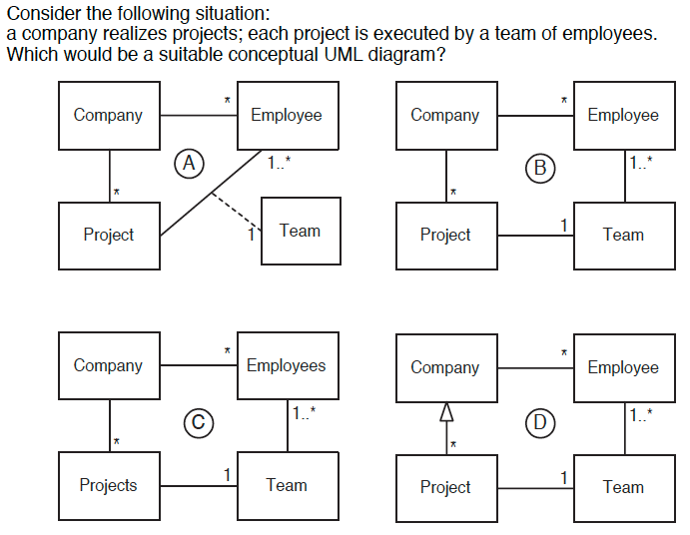

Slide 37
Exercise
Develop UML Class diagram for a software that we need to develop to manage a library.
Each library member has a name, date of birth, address, phone number and email
Each journal has a name, ISBN code, subject areas, shelf where it is located and an editor. Each editor has a name and a nationality and publishes many journals.
A journal may cover issues in several subject areas. It is important to store the order of appearance of areas, since these indicate their relative importance for the journal.
It is important to keep track of the date on which each journal has been borrowed, returned, disappeared, and the member carrying out the operation.

Slide 38
AreaOrder
-orderOfApperarance
1..*
1..*
Editor
Journal
Area
-editorName
-nationality
publishes
-journalName
ISBN
-shelf
Addressed in
-areaName
areaDetails
1
*
*
Operation
Performs
operation
-date
-operationType
*
Member
-userName
-address
-birthDate
-phone
-email

Slide 39
Interface
An interface in UML is a named set of operations.
Interfaces are used to characterize the behaviour of some classes.
  Shown as a stereotyped class.
<<interface>>
List
Add( )
isEmpty( )
…
Generalization can be defined between interfaces.

Slide 40
Interface Example
An interface specifies the set of services to be offered by a class.
Cylinder
<<interface>>
Shape
Draw
Move
Scale
Rotate
Pyramid
Cube
Realization relationship
Notes:
Interfaces are not abstract classes, as abstract classes allow you to provide default behavior for some/all of their methods. Interfaces provide no default behavior.
From the UML User’s Guide (Booch, 1999): An interface is “a collection of operations that are used to specify a service of a class or a component.”
Interfaces formalize polymorphism. Interfaces allow us to define polymorphism in a declarative way, unrelated to implementation. Two elements are polymorphic with respect to a set of behaviors if they realize the same interfaces (e.g., any two “things” which realize the same interface can be said to be polymorphic). You always heard that polymorphism was this big benefit of object orientation, but without interfaces there was no way to enforce it, verify it, or even express it except in informal ways, or language-specific ways. Formalization of interfaces strips away the mystery, and gives us a good way to describe, in precise terms, what polymorphism was trying to do all along. Interfaces are testable, verifiable, and precise.
Interfaces are the key to the “plug-and-play-ability” of an architecture: Any classifiers (e.g., classes, subsystems, components) which realize the same interfaces may be substituted for one another in the system, thereby supporting the changing of implementations without affecting clients.
Realization relationships are discussed later in this module.

Slide 41
Realizing an Interface
A class realizes an interface if it provides implementations of all the operations.
  Similar to the implements keyword in Java.
UML provides two equivalent ways of denoting this relationship:
CircularLinkedList
<<interface>>
List
CircularLinkedList
List
  Both represent: “CircularLinkedList implements all the operations defined by the List interface”.

Slide 42
Interface Dependency
A class can be dependent on an interface.
  This means that it makes use of the operations defined in that interface.
  E.g., the Restaurant class makes use of the List interface:
Restaurant
<<use>>
List

Slide 43
Collection
List
<<interface>>
<<interface>>
Java Provides a List interface for several implementations
AbstractList
<<abstract>>
ArrayList
Vector
AbstractSequentialList
<<abstract>>
Stack
LinkedList

Slide 44
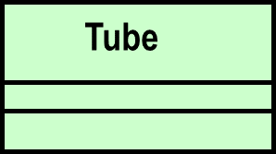
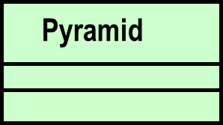
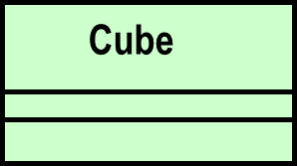
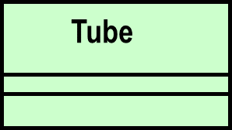
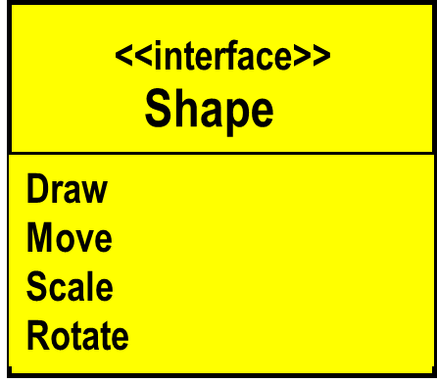
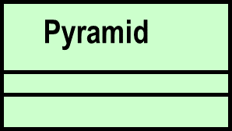
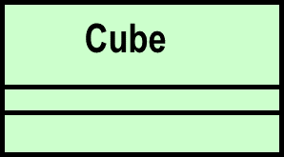
Interface Representations
Alternate Representations
Shape
Implementors
Service description
Notes:
The lollipop notation is best used when you only need to denote the existence of an interface. If you need to see the details of the interface (e.g., the operations), then the class/stereotype representation is more appropriate.
From The Random House Collegiate Dictionary:
Elide: “to pass over; omit; ignore.”
Canonical: “authorized; recognized; accepted.”

Slide 45
Interface Diagram Example
Storable
Class A
Class B
Runnable
<<interface>>
Runnable
<<interface>>
Storable
Class C
run() {}
load() {}
save() {}
Runnable
Class A implements the interfaces Runnable and Storable. Class C implements the interface Runnable. Class B uses the interface Runnable and Storable from A, and Runnable from C.

Slide 46
UML Packages
A package is a general purpose grouping mechanism.
  Can be used to group any UML element (e.g. use case, actors, classes, components and other packages.)
Commonly used for specifying the logical grouping of classes.
A package does not necessarily translate into a physical sub-system.
Name

Slide 47
Mapping to Code
MyPackage
package MyPackage;
abstract class MyAbstractClass{}
class MyDerivedClass extends MyAbstractClass{
int att;
void myFunction() { .. }
}
MyAbstractClass
MyDerivedClass
att: int
myFunction()

